Slide 1
Access 2016 Module 1
Getting Started with Access 2016

Slide 2
Module Objectives
Understand relational databases
Explore a database
Create a database
Create a table
Create primary keys
Relate two tables
Enter data
Edit data

Slide 3
Understand Relational Databases (Slide 1 of 3)
Relational database software
Data organized into lists
Examples – customers, products, vendors, employees
Access provides tools that allow
Sorting, grouping, analyzing and reporting data in many different ways

Slide 4
Understand Relational Databases (Slide 2 of 3)
Duplicate data minimized
Information is more accurate, reliable and consistent
Data entry is faster and easier
Data can be viewed and sorted in many ways
Information is more secure
Data can be shared and edited by several users simultaneously

Slide 5
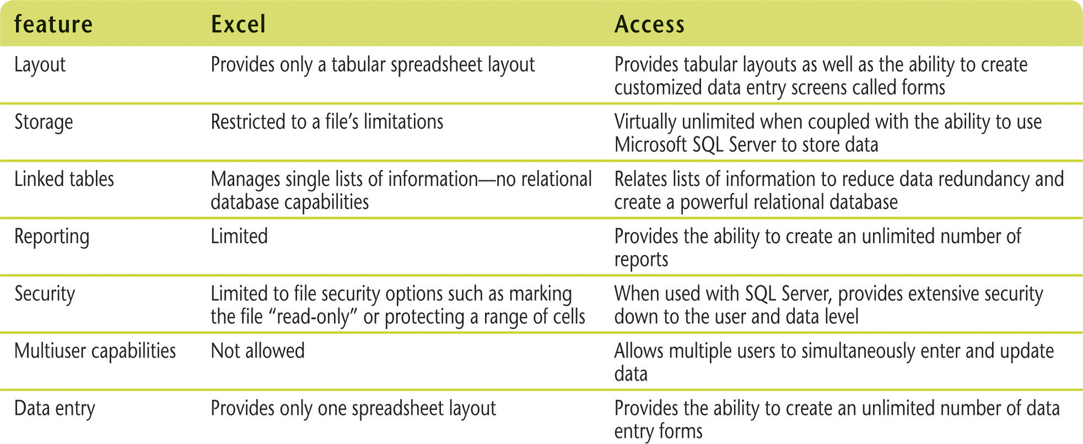
Understand Relational Databases (Slide 3 of 3)
Excel vs. Access Comparison

Slide 6
Explore a Database (Slide 1 of 3)
Can start Access in different ways
Database contains different objects
Tables
Queries
Forms
Reports
Navigation Pane displays objects

Slide 7
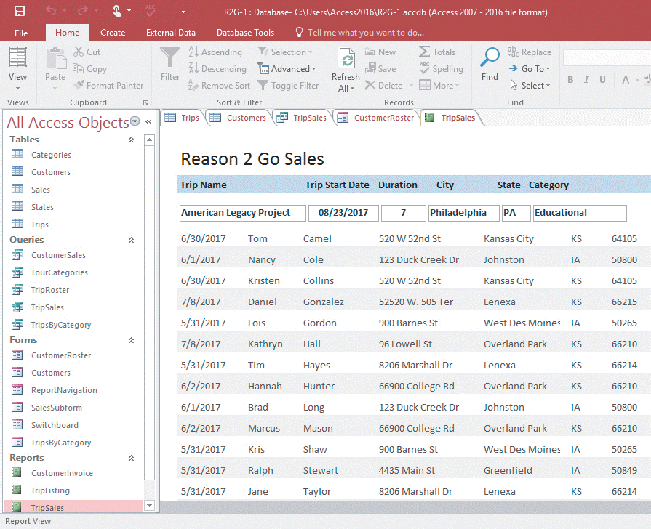
Explore a Database (Slide 2 of 3)
Objects in a database

Slide 8
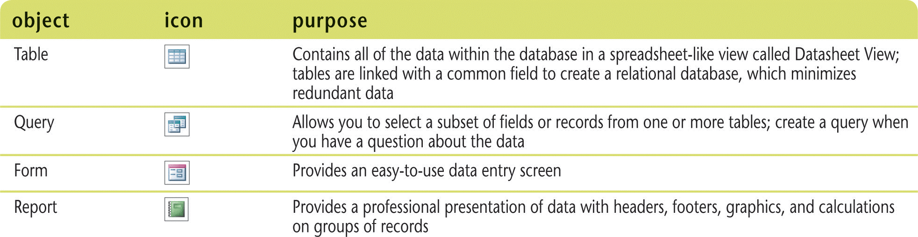
Explore a Database (Slide 3 of 3)
Access objects and their purpose

Slide 9
Create a Database (Slide 1 of 2)
Use an Access template (sample database) or create a blank database
Table Design View
provides the most options for defining fields
Datasheet View
spreadsheet-like view of the data in a table
Data type
Characteristic of a field

Slide 10
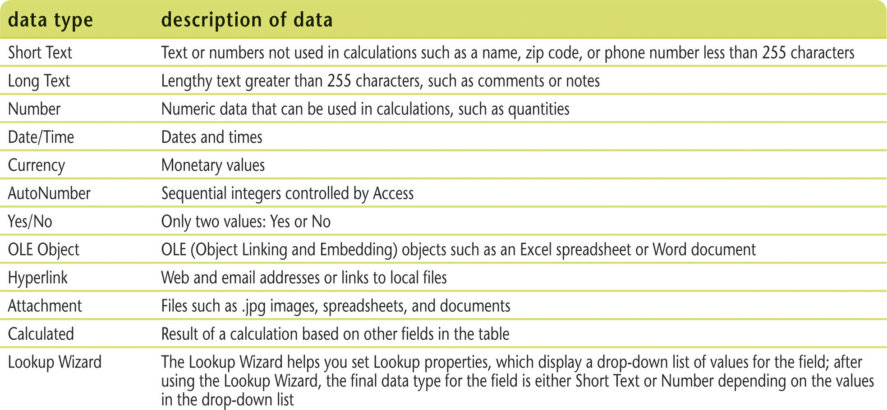
Create a Database (Slide 2 of 2)
Data types

Slide 11
Create a Table (Slide 1 of 2)
Essential tasks
Define the fields
Select data type for each field (e.g., numbers, text, dates)
Name the table
Determine how the table will participate in the relational database
Identify primary key
Field that contains unique data for each record

Slide 12
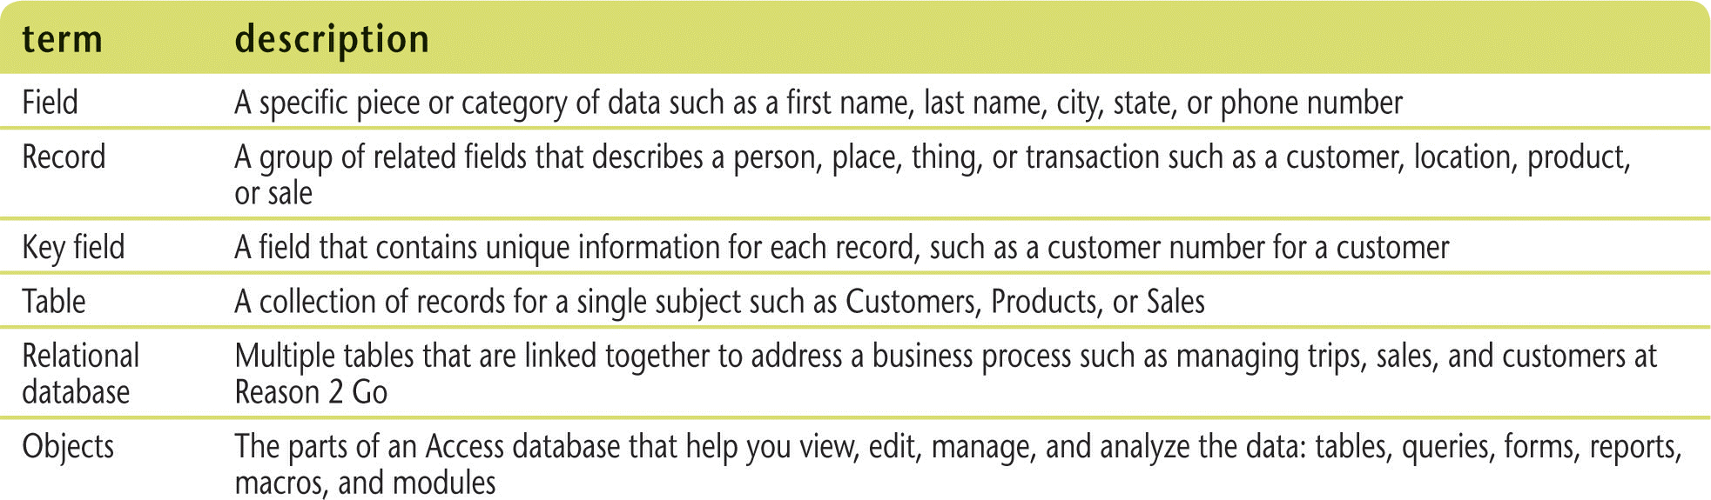
Create a Table (Slide 2 of 2)
Important database terminology

Slide 13
Create Primary Keys (Slide 1 of 2)
Primary key field
Contains data that uniquely identifies each record
No two records can have the exact same entry in primary key field
Helps relate one table to another
One-to-many relationship (one record in one table relates to many records in another table)

Slide 14
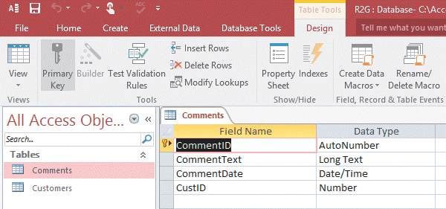
Create Primary Keys (Slide 2 of 2)
Creating a primary key field

Slide 15
Relate Two Tables (Slide 1 of 2)
Create a one-to-many relationship
Use a common field to relate tables
Primary key is the “one” side of the relationship
Foreign key is the “many” side of the relationship
One-to-many line shows the link with a “1” on the one side and an infinity symbol on the many side
In Datasheet view, subdatasheet shows related records (records in the many table)

Slide 16
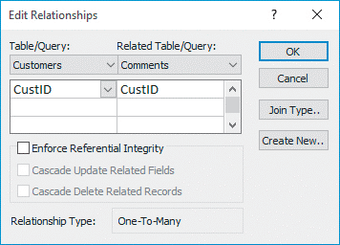
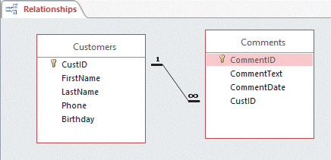
Relate Two Tables (Slide 2 of 2)
Creating a one-to-many relationship

Slide 17
Enter Data (Slide 1 of 2)
Focus
Which data you would enter or edit if you started typing
Options for changing focus
[Tab]
[Enter]
Navigation buttons:
Previous record
Next record

Slide 18
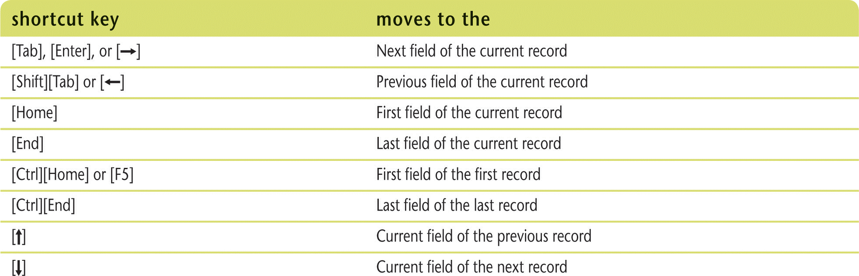
Enter Data (Slide 2 of 2)
Navigation mode keyboard shortcuts

Slide 19
Edit Data (Slide 1 of 2)
Access automatically saves new data and changes to existing data as soon as you move to another record OR close the datasheet
To change the contents of an existing record, navigate to the field you want to change and type the new information
Press [Esc]
Once to remove the current field’s editing changes
Twice to remove all changes to current record

Slide 20
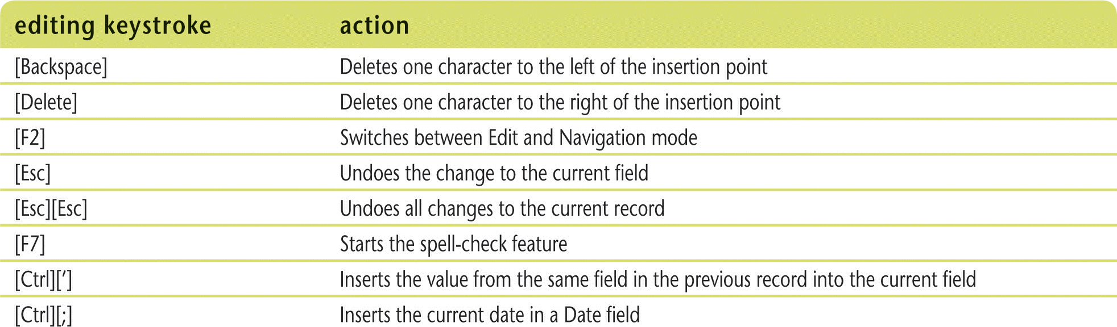
Edit Data (Slide 2 of 2)
Edit mode keyboard shortcuts

